Slide 1
CV Projects
Tracking
Tutor contacts: niccolo.bisagno@unitn.it
giulia.martinelli-2@unitn.it

Slide 2
Projects for A.Y. 2024-2025
What we expect:
Look for state of art methods
Implement and test
Improve
Read as much as you can
Make assumptions
Record videos
Use pre-recorded data

Slide 3
Projects for A.Y. 2024-2025
What we expect when ask for a meeting?
Show that you tried
Show difficulties encountered and actions taken to resolve

Slide 4
Notes!
Deep Learning is welcome, but not required (we cannot provide GPUs)
Videos are for internal use only. Do not share them.
The evaluation of your project depends more on your interaction with the tutor rather than on the numerical results
The goal of the project is for you to learn something and face the real-world issues
The project is individual for each group, but you are allowed to communicate, share ideas, share best practices. It is not a competition.
Anyone does not have a group and would like to join one?

Slide 5
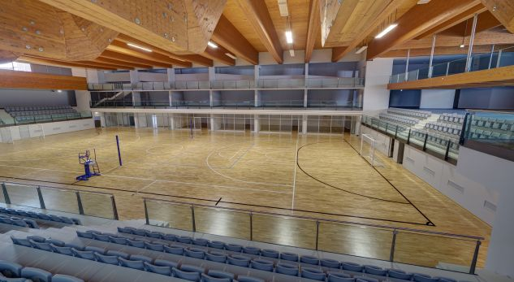
Sanbapolis facility

Slide 6
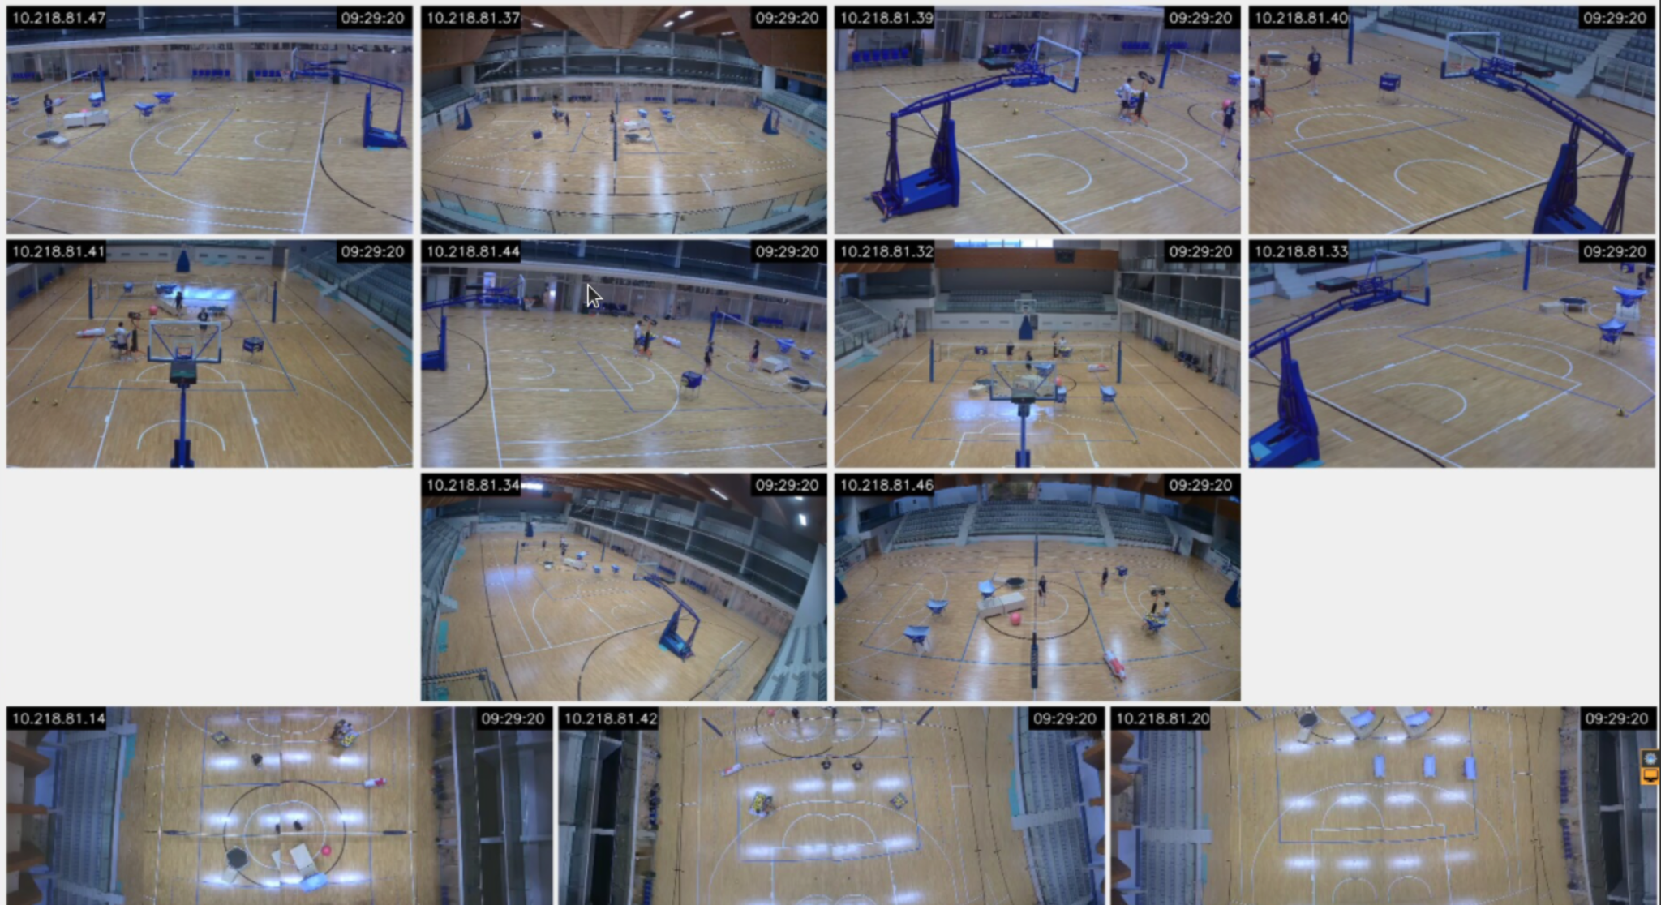

Slide 7
Project Goal and step
Using the multi-view camera setup at Sanbapolis, track players and the ball
Annotate bounding boxes for players, referees, and the ball in each camera view.
Perform 2D tracking of players and the ball across frames for each camera.
Provide numerical results for the annotated ones.
Reconstruct 3D trajectories of players (center of bounding boxes) and the ball using triangulation across multiple camera views.
Provide numerical results for the annotated ones.
Visualize the 3D tracking by importing the reconstructed motion into Unreal Engine.
Team of 1 pp: task 1,2,2a,3 is mandatory using one camera. Bonus: task 3a.
Team of 2 pp: task 1,2,2a,3,3a is mandatory using two cameras. Bonus: task 4.
Team of 3 pp: task 1,2,2a,3,3a,4 is mandatory using two cameras. Bonus: use 3 cameras.

Slide 8
Material
presentation, data https://drive.google.com/drive/folders/1Q-rtCw4ZDPJQkiilJ8eHLznOjBfu9wUN?usp=share_link
Roboflow https://app.roboflow.com/tracking-rybv7
Best project from last year CV course https://drive.google.com/drive/folders/1XubKVV17PyYkZ7okoGtY8wFOGA_sDTWO?usp=share_link

Slide 9
Annotate Bounding Boxes
There are 3 camera viewpoint for each action
One action per group
Around 100 frames per person
if your team is made up of 1 pp -> annotate only out13
if your team is made up of 2 pp -> annotate out13 + out4
if your team is made up of 3 pp -> annotate out13 + out4 + out2
register to Roboflow (one account per group)
send to the tutor one email per group to be added to Roboflow
for testing and evaluation it is mandatory to use at least the action you have annotated. You can test and evaluate on actions annotated by other groups.

Slide 10

Annotate Bounding Boxes

Slide 11
2) 2D Tracking
Annotation is performed at 5 fps
Perform tracking at native frame rate (25fps)
Use standard metrics for evaluation (search state of the art, e.g. IOU)

Slide 12
3) 3D Tracking
Goal: Use camera parameters to perform triangulation of the tracked/GT 3D positions of the players and the ball
Rectified the video at input (code is provided. Remember: if you rectify the video you also have to apply the same transformation to the GT/the coordinates you have tracked).
Triangulation
Display 3D position of players and ball
3a) Provide results using common tracking metrics (eg. trajectories metrics, …)

Slide 13
4) (Bonus) Unreal Engine
Display 3D data on Unreal. (contact tutor for more details)

Slide 14
How do I deliver my project?
Share with tutor a drive folder containing:
Code (on a zip + git)
Dataset (if not standard)
Report with results (max 3-6 pages) (LNCS format, PDF)
Video results
Video (5 minutes) including
Motivations and background
State-of-the-Art
Deadline: whenever you want. If you want to have the mark registered in a specific session, please submit your project one week before the oral exam date

Slide 15
Project’s Score
Written exam score: 12 points
Max project score: 18 points + 1 bonus
Video (6pt)
Code(6pt)
Report (2pt)
Supplementary (e.g sample video results) (2pt)
Independence in carrying out a project (2pt)
Bonus Task (1pt)

